Slide 1
SoundSelect Array System (SSAS)
Direction Hearing Aid Capstone Tim Deignan, Keenan Hye, Mark Long, Steve Muscari, Jack Tarricone
Notes:
(JACK)

Slide 2

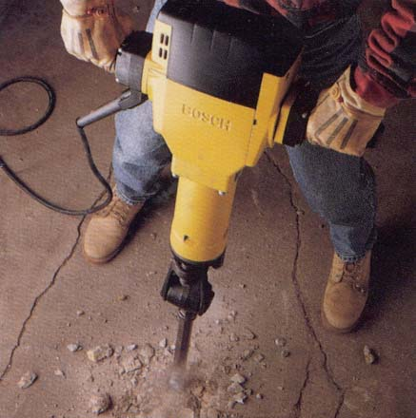
The Problem – Hearing Loss
Notes:
(JACK)

Slide 3
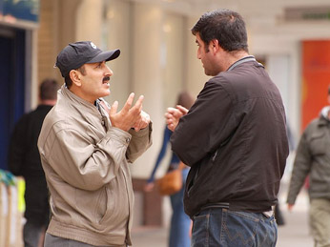
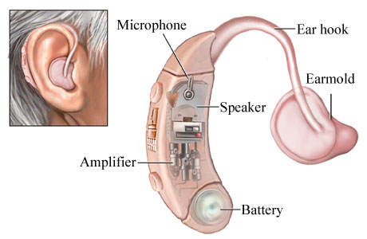
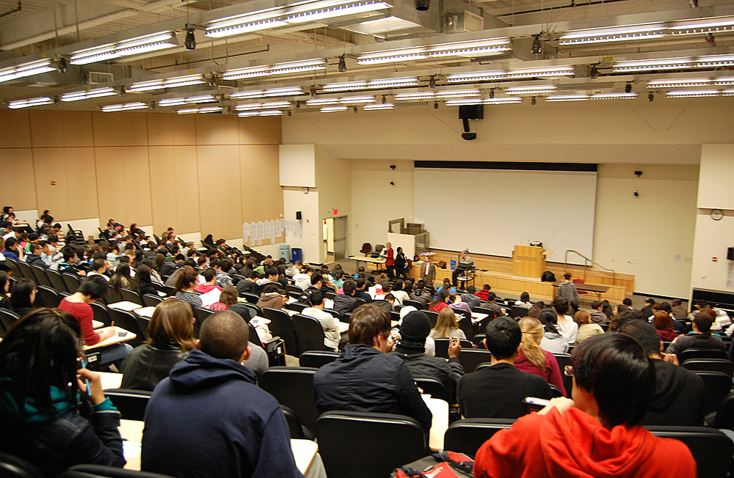
Existing Solutions
Notes:
(JACK) Existing Hearing Aids do help, and are generally sufficient in a near-field situation. The far field, however, is a different story.

Slide 4
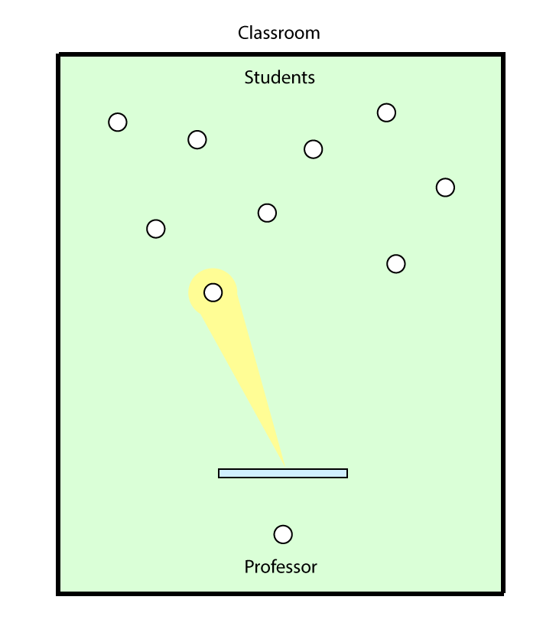
Our Solution
Spatial Isolation
Microphone array beamforming
Speech Band Composition
Microphone array design
Real-time filtering
Implementation
FPGA
Control & Operation
Notes:
(JACK)

Slide 5
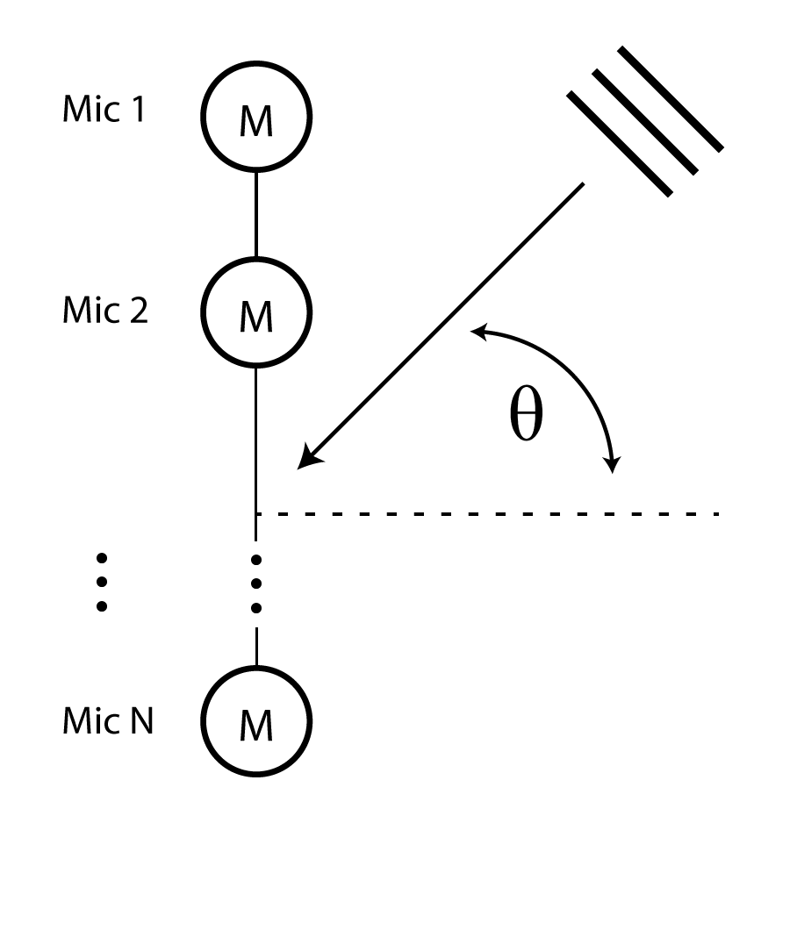


array beamforming
Output of the microphone array:
$y\left(t\right)=\frac{1}{N}\sum{x\left(t\right)}$
Wavefront delay at microphone n:
$τ_{n}=\frac{\left(n − 1\right)d\sin\left(θ\right)}{c}$
Notes:
(STEVE) For a mic array with no signals processing funny business, incoming wavefronts that aren’t at theta = 0 degrees see this time delay tau before hitting mic n, which introduces destructive interference for every direction except perpendicular to the array. So we say the array is most directional at theta = 0.

Slide 6
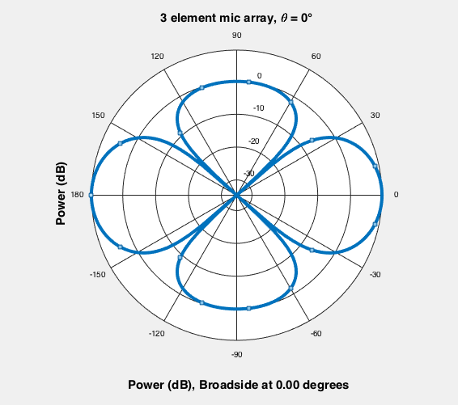
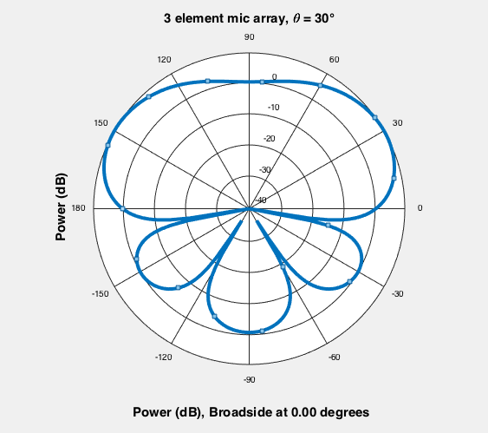

Array beamforming
$$w_{n}\left(f,θ\right)=\frac{1}{N}e^{−j2πfτ_{n}}$$
Scale to virtually shift microphone n:
Notes:
(STEVE) We can sort of reverse this and introduce artificial delays to the signal arriving at each mic in order to “steer” the array without actually moving any mics. To steer the mic array at direction theta, say 30 degrees, we multiply the frequency-domain signal seen by mic n by this complex weight (phasor) w_n and choose theta = 30 to get tau.

Slide 7
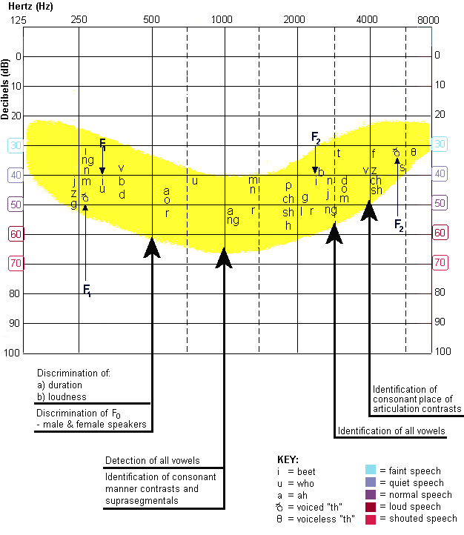
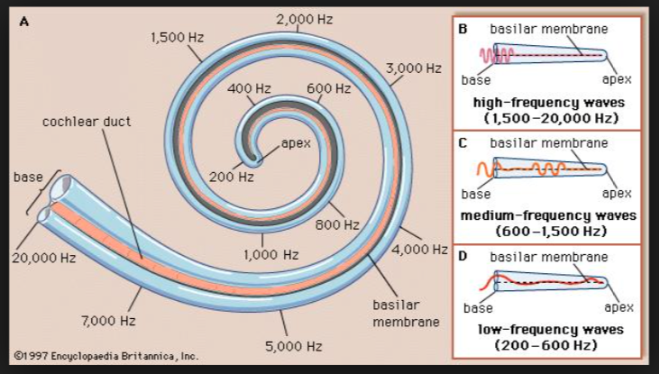
Human Hearing & Speech
Notes:
(KEENAN)

Slide 8
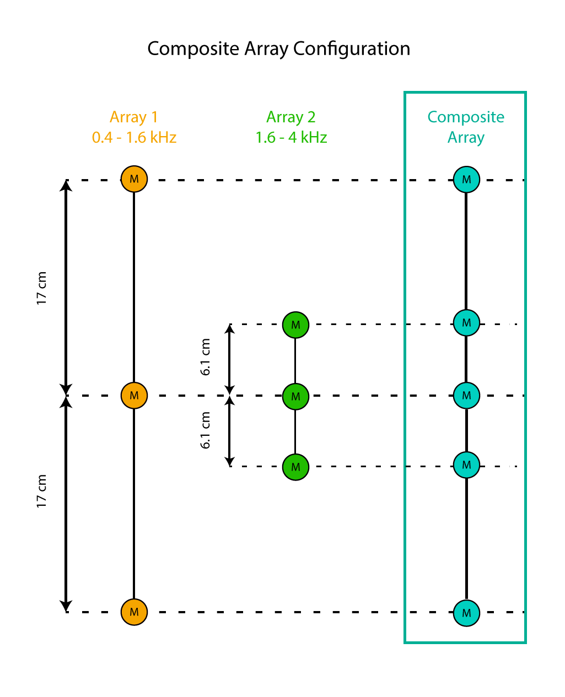
Composite array
Human Speech spans ~ 400 – 4000 Hz
Wavelengths span 86 – 8.6 cm
Notes:
(TIM) Arrays should be tuned for narrow frequency bands

Slide 9
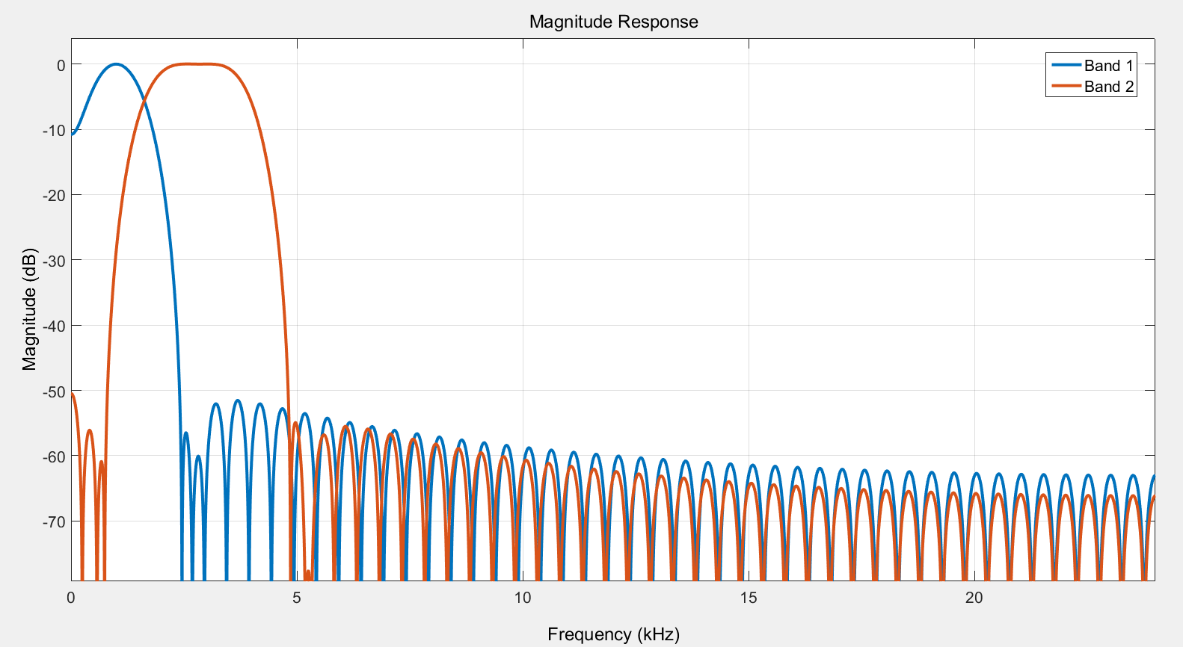
Real-time FIR filtering
Linear phase
Constant group delays
Inherently stable
Notes:
(KEENAN)

Slide 10
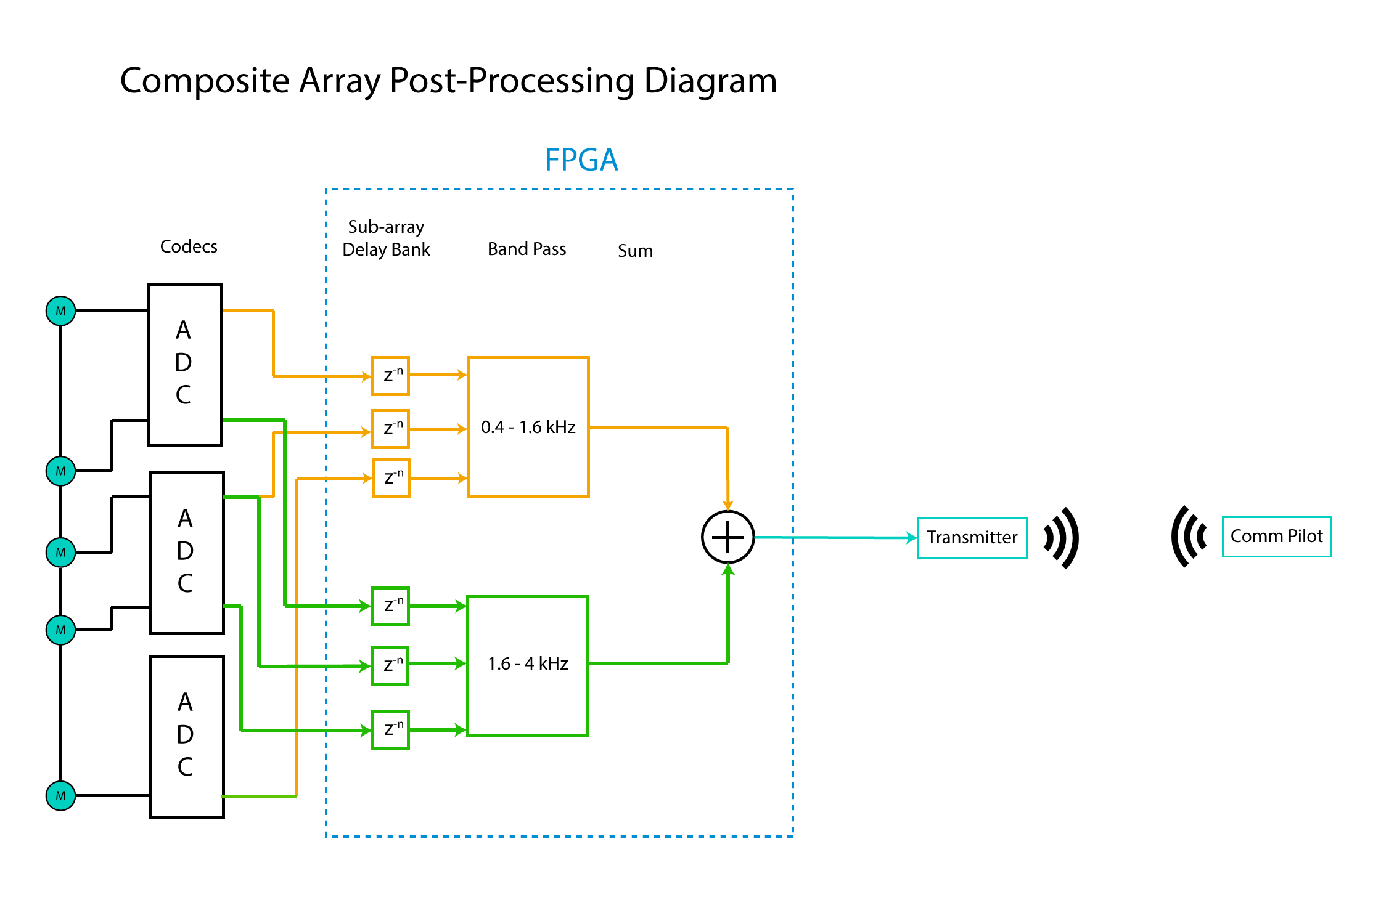
Notes:
(KEENAN)

Slide 11
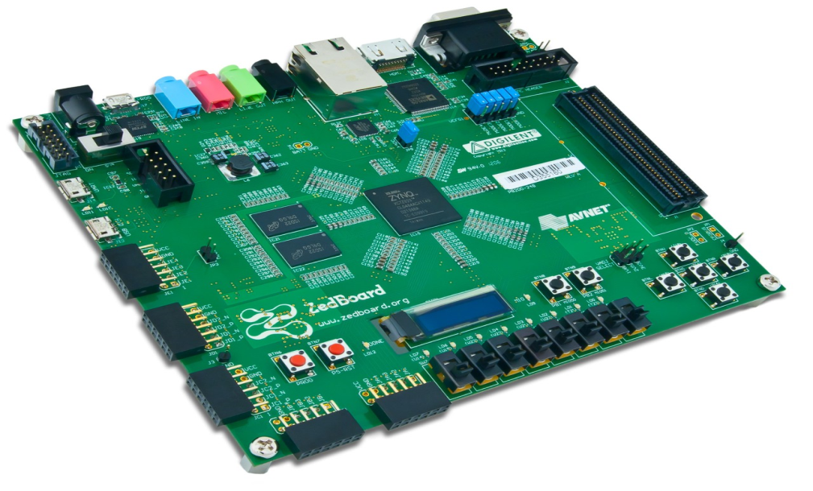
ZedBoard
Algorithm requires instantaneous parallel operations not possible in a CPU
All audio processing is conducted on the FPGA
Notes:
(MARK)

Slide 12

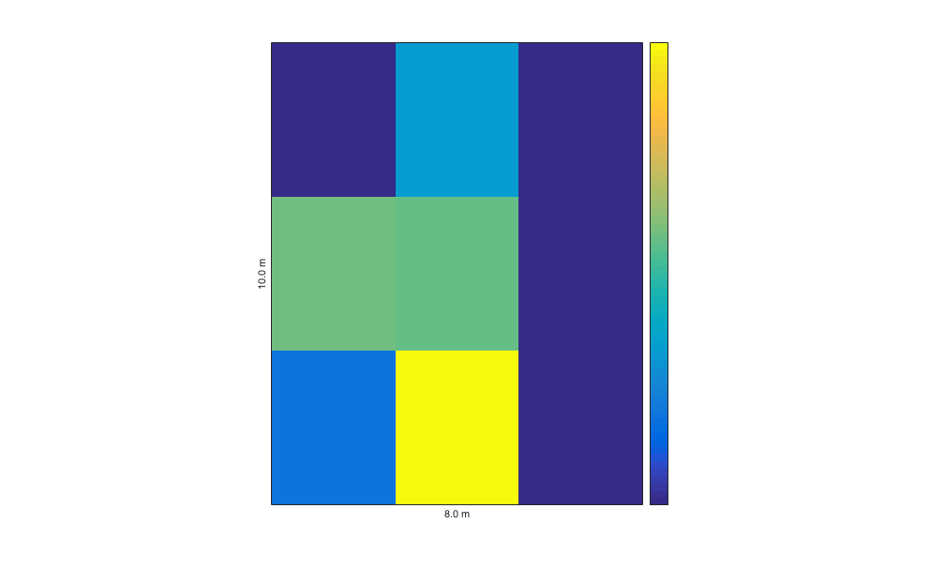
Control & Operation
0
-2
-4
-6
-8
User selects directions ranging from -90° to 90°
Notes:
(STEVE)

Slide 13
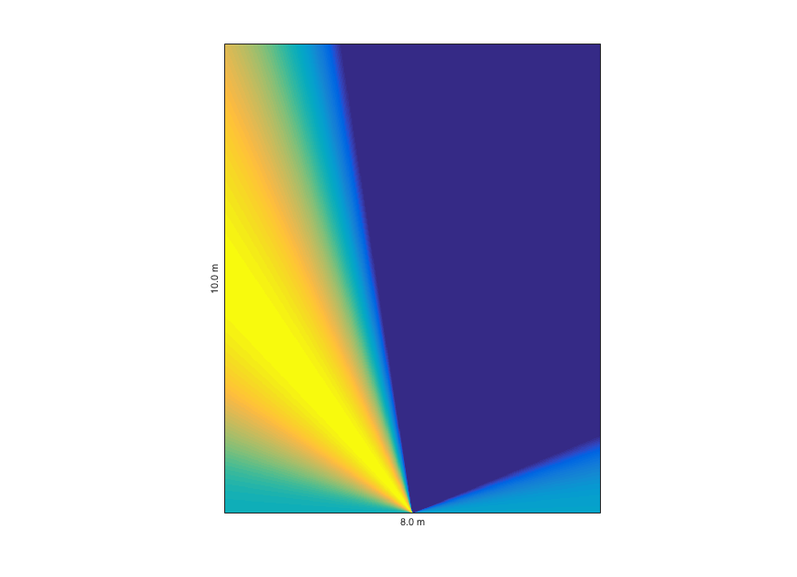
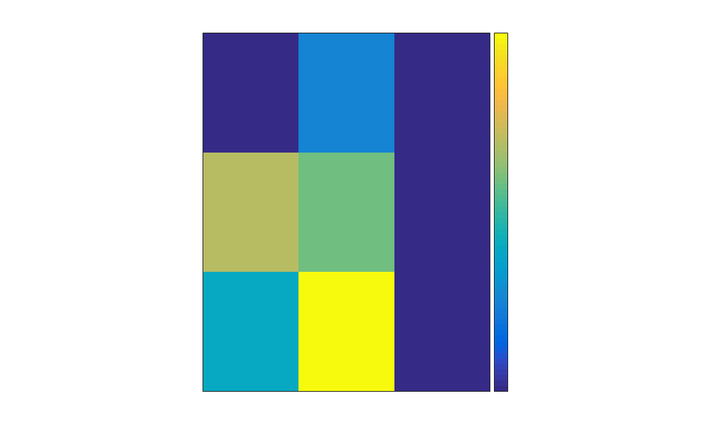

Predicted vs actual results
0
-2
-4
-6
-8
Notes:
(TIM)

Slide 14
Budget & Cost sheet
Item | Notes | Unit Cost | Quantity | Total Cost
Zedboard | *Donated by ECE Lab | $319.00 | 1 | $319.00
MEMS Microphone |  | $1.01 | 10 | $10.10
Audio Codecs | Assembled on board | $34.04 | 3 | $102.12
DC Power Supplies | 3.3 V, 500 mA | $8.76 | 5 | $43.80
25’ Audio Cables | 3.5 mm Stereo | $7.00 | 5 | $35
Misc. Electronic Components | Resistors, Capacitors, barrel connectors, Voltage Regulators |  |  | ~$50
Misc. Hardware components | Velcro, Tape, Wood blocks |  |  | ~$50
Total |  |  |  | $610.02
*Total Spending by our team was $780. The above represents only components used in our final design
Notes:
(MARK)

Slide 15

Future Steps
Having an FPGA with more logic blocks would permit:
Higher order filters for a sharper response
More microphones per array for sharper reception regions
More subarrays to support narrower subbands
Additional microphone arrays to support an additional dimension of isolation
Bluetooth support
Notes:
(MARK)

Slide 16
Thank you
Notes:
(MARK)

Slide 18
Predicted vs actual results
0
-2
-4
-6
-8
Notes:
(TIM)

Slide 19
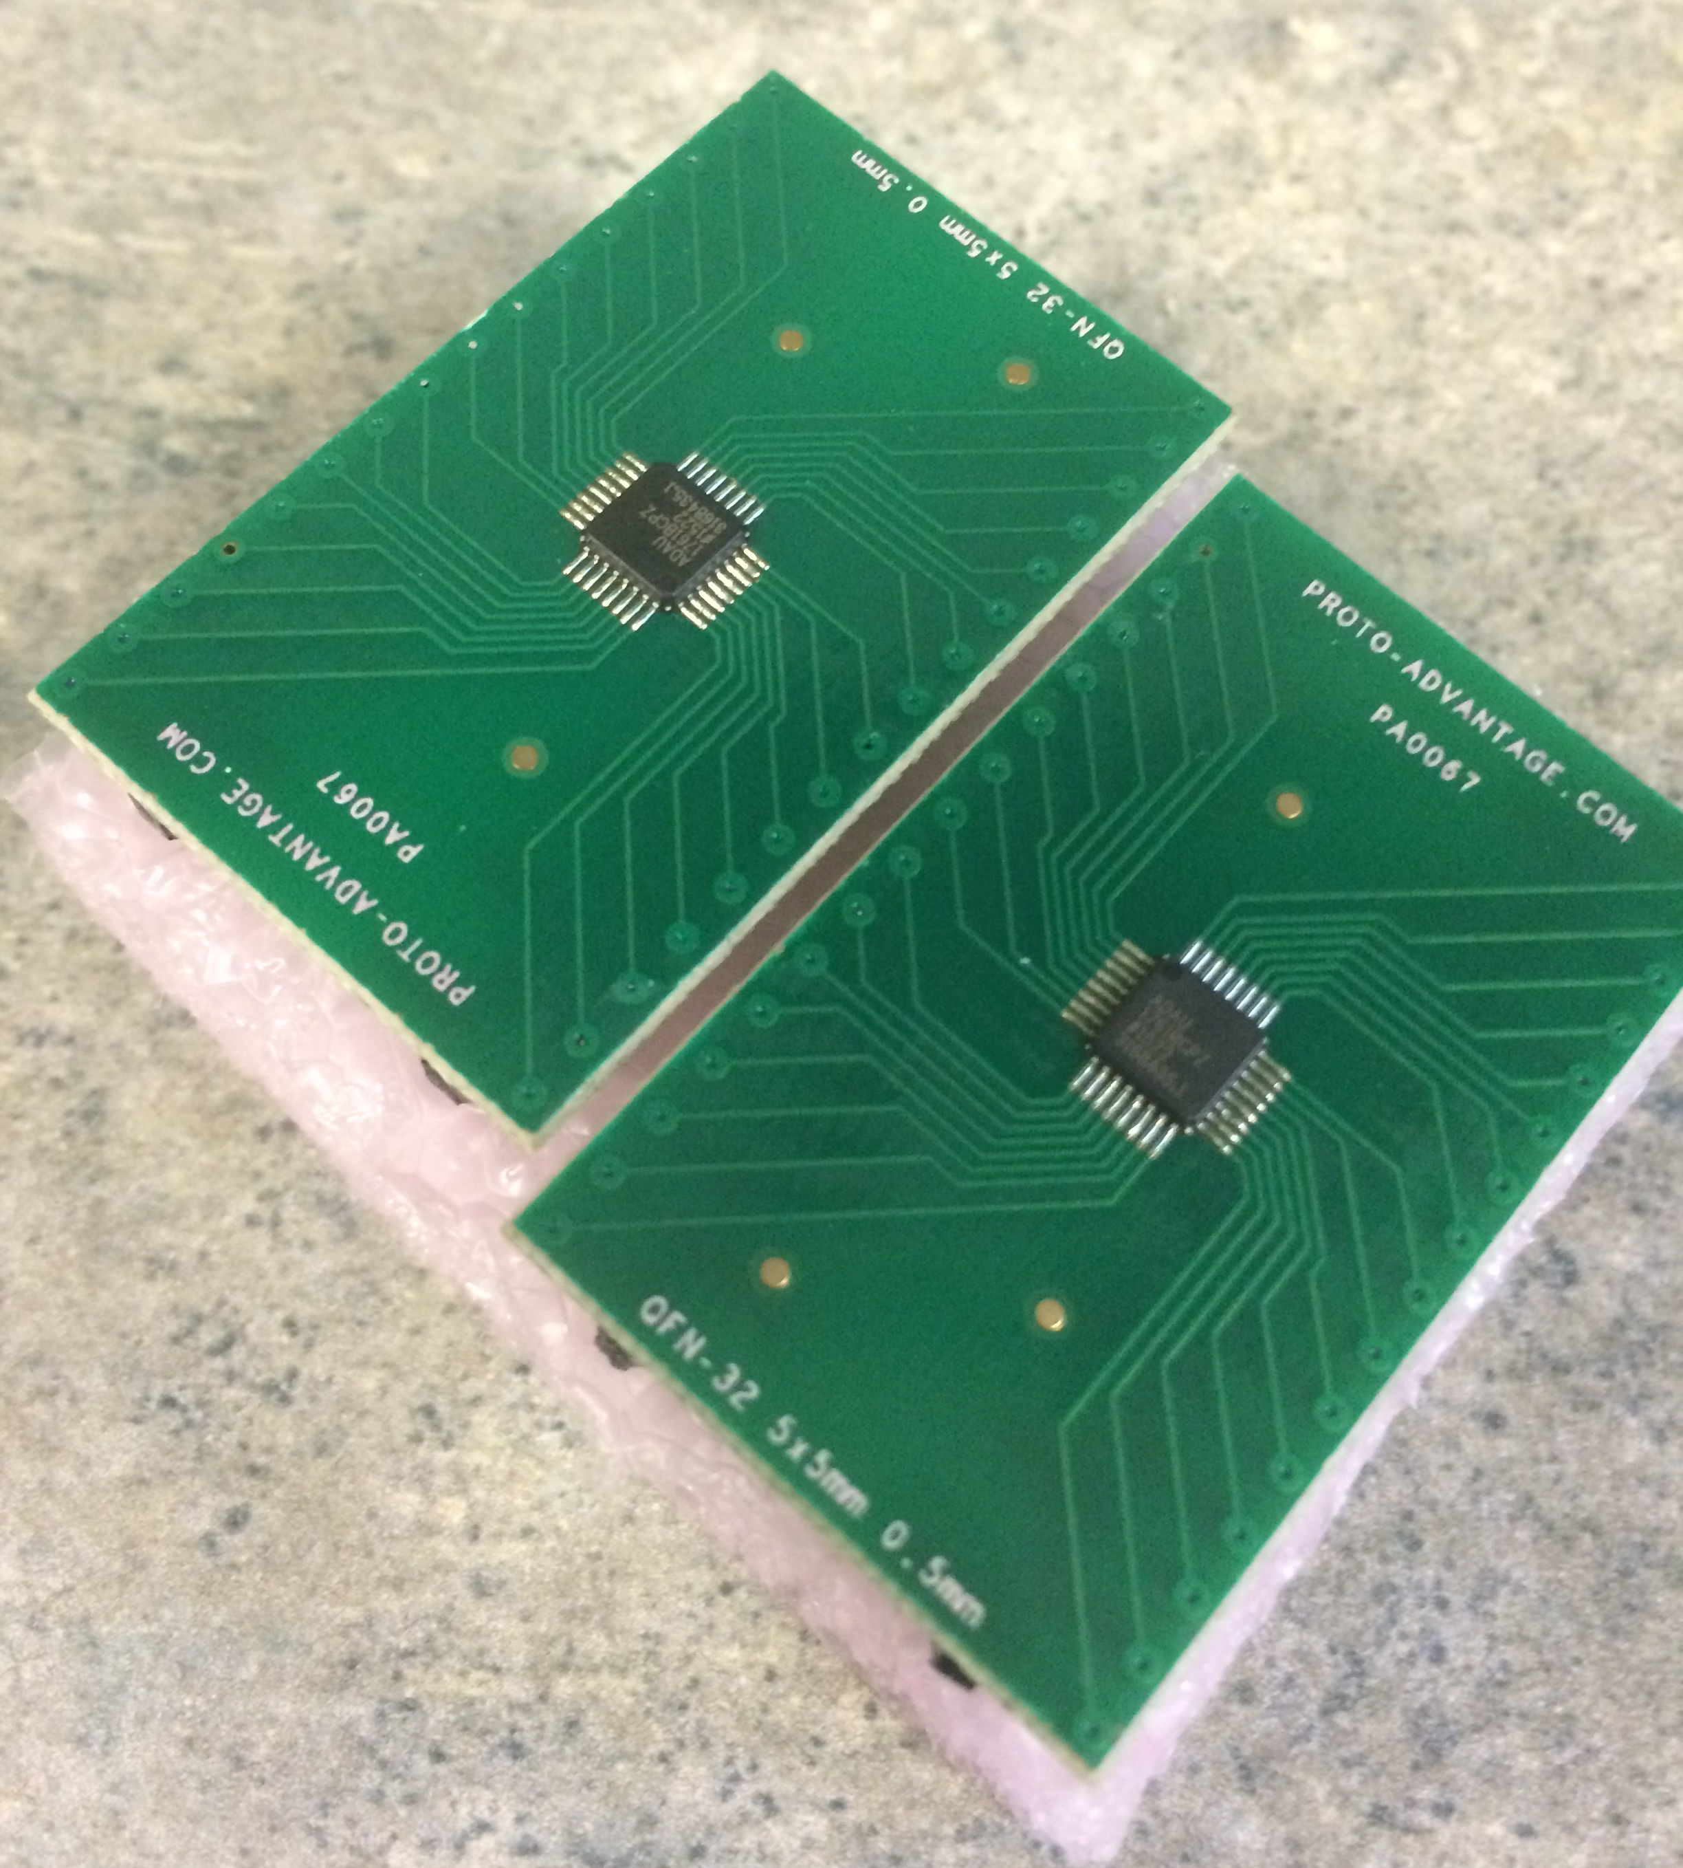
Audio codecs
i2s audio standard
24-bit resolution
48 kHz sampling rate
Programmed via i2c

Slide 20
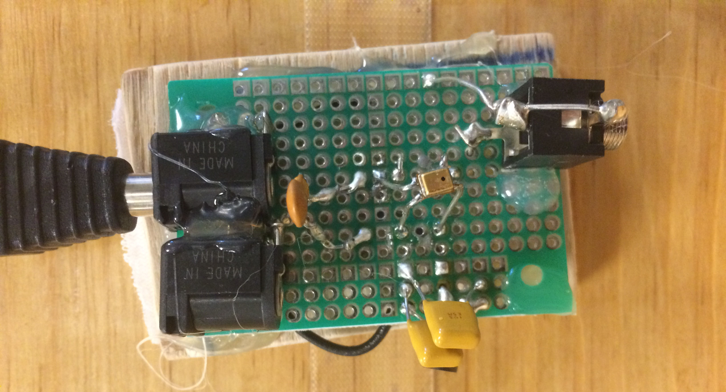
Mems microphones
Omnidirectional
High sensitivity
High gain amplifier

Slide 21
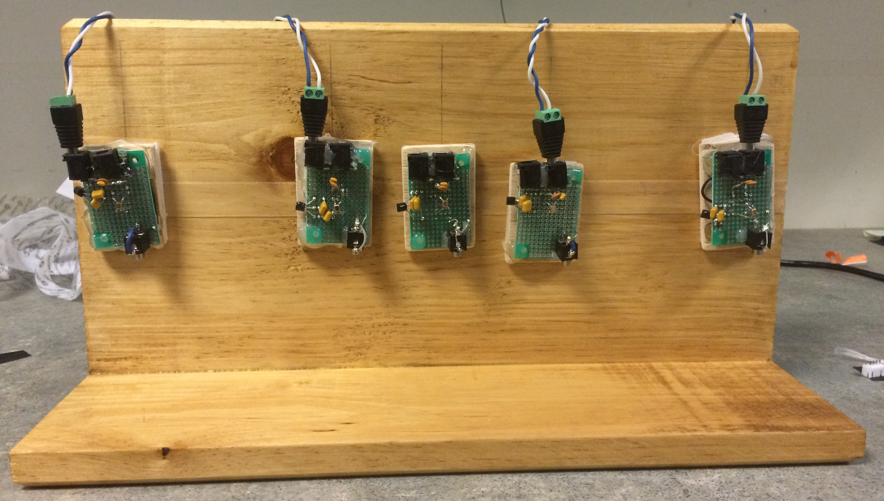
Microphone Array

Slide 22
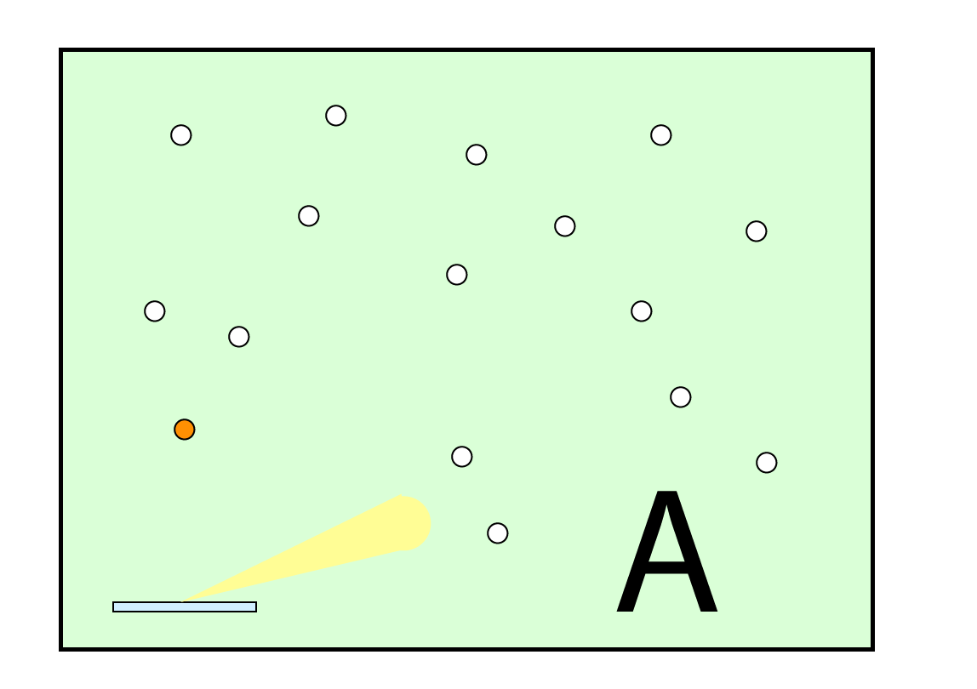
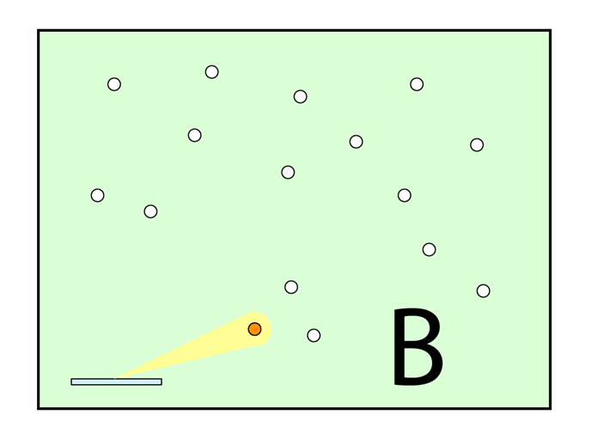
Loud Environment
Off axis
On axis

Slide 23
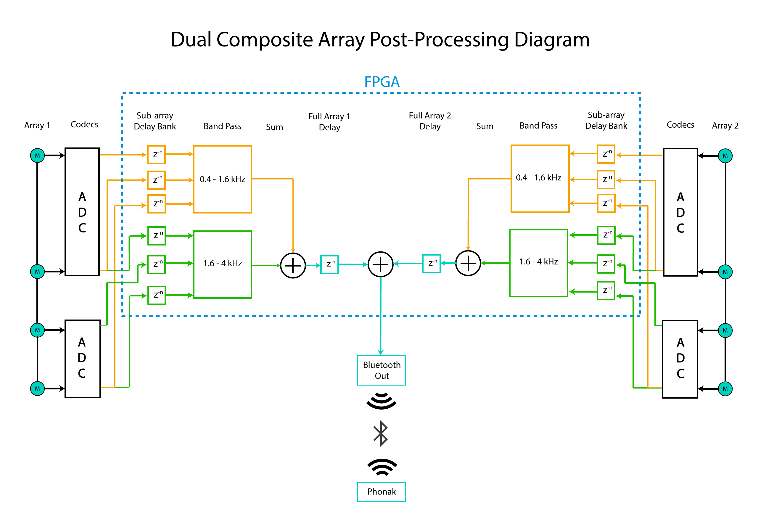

Slide 24
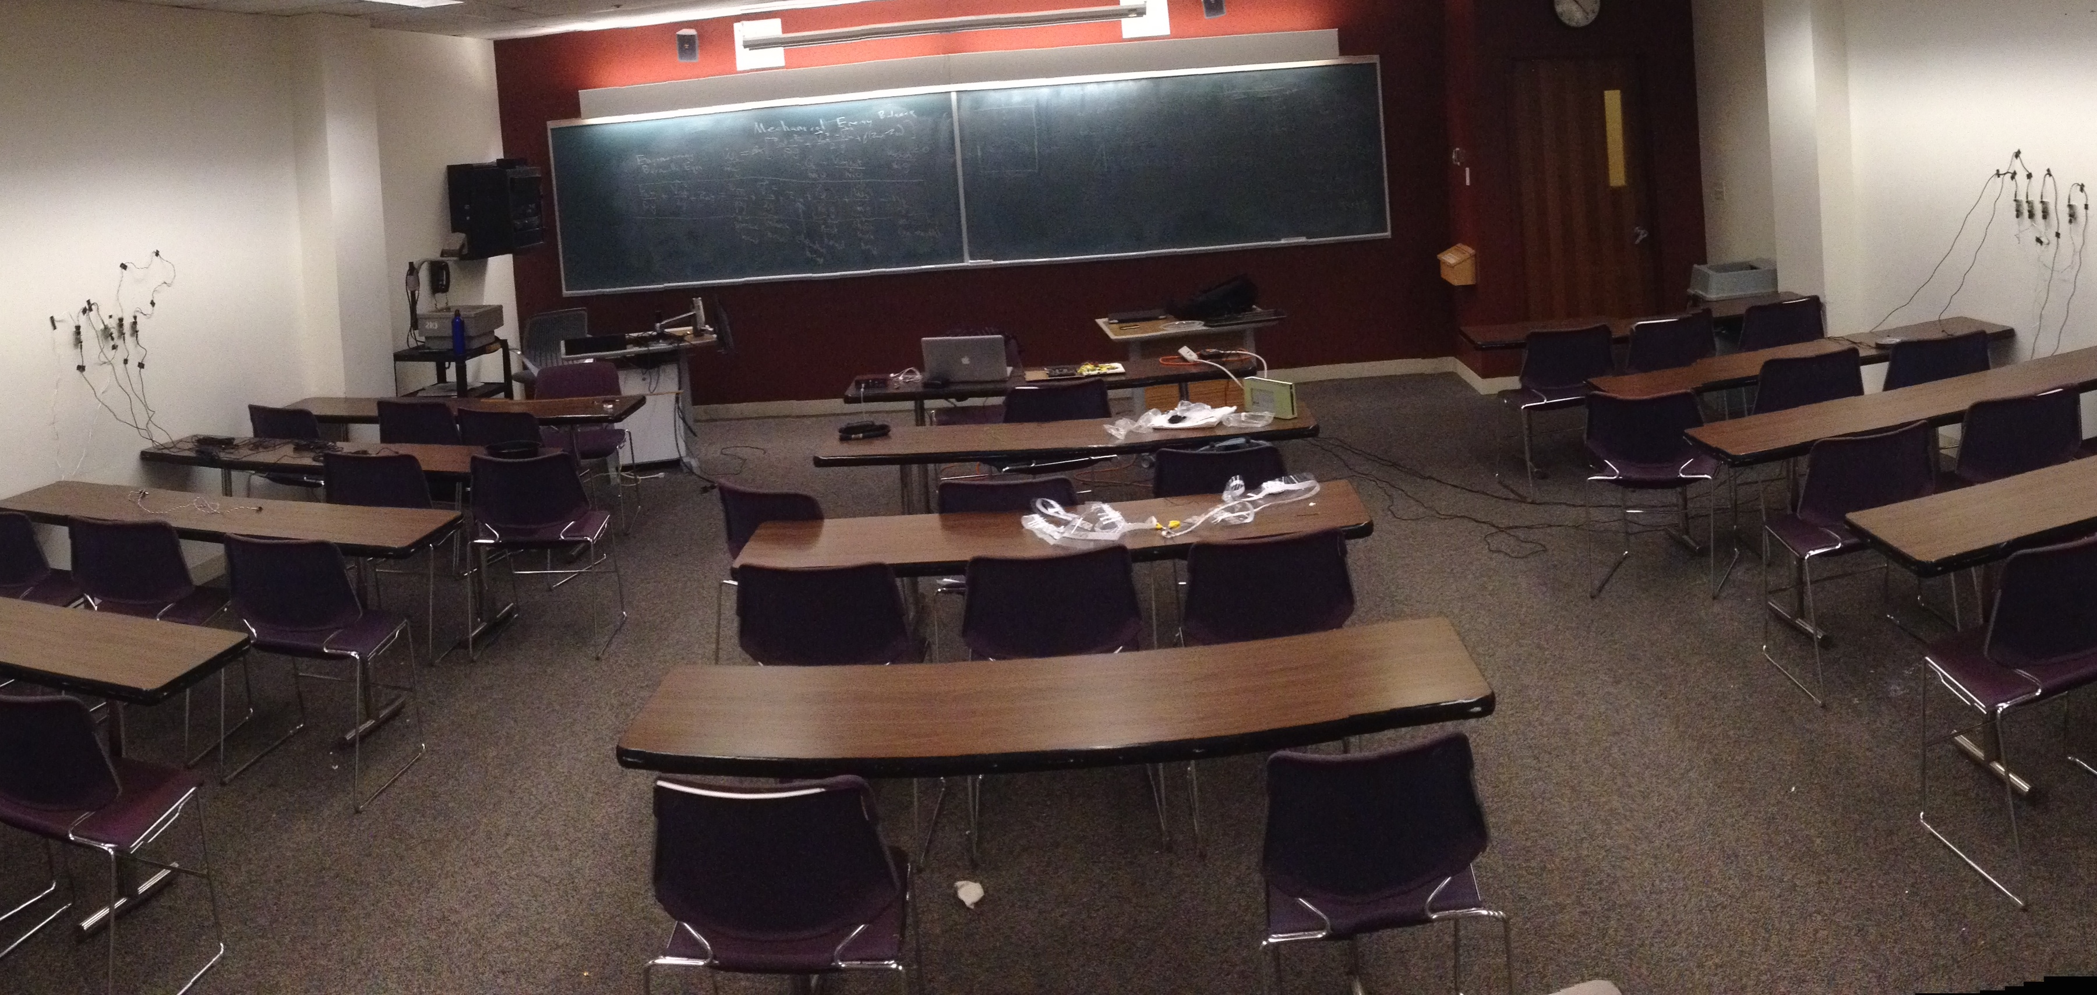
Notes:
(MARK)

